Slide 1
FERTILIZER PREDICTION
TEAM MEMBERS :
Mahendra
Hemanth
Subhash

Slide 2
Objective
This project is aimed at developing a suitable fertilizer for the farmers to yield the crops and to maintain the fields in the proper manner. We can decide the pests that should be used in according to the crop and soil type by using this machine learning techniques.

Slide 3
Introduction
India is the leading producer crops and the lack of fertility is The reasons are lack of irrigation facilities, improper pest management, soil erosion due to natural calamities. The Machine learning algorithms like regression algorithms are used to predict the crop yield based on fertilizer consumption. This helps the farmers to decide the quantity of fertilizer to be used in the cultivation. Simple Linear regression model involves one predictor variable. Multiple linear regression model involves more than one predictor variables.

Slide 4
Problem Statement
To predict a suitable fertilizer that yields profitable results for a given plant soil combination with the help this fertilizer prediction.
This fertilizer prediction is useful for the farmers to make a decision that what time which pest should be used. They can get a conclusion based on their soil and crop type.

Slide 5
Modules
Importing data into python
Data cleaning
Data spliting
Training data
Model evaluate
Testing data
Data prediction

Slide 6
Inputs and outputs
Inputs: Outputs:
Temperature 1. Fertilizer
Humidity
Moisture
Soil type
Crop type

Slide 7
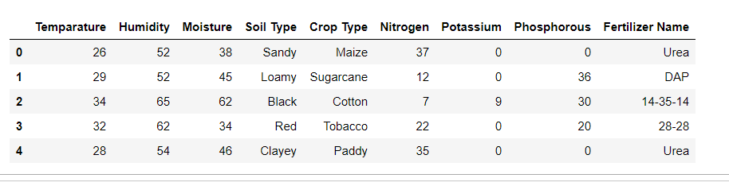
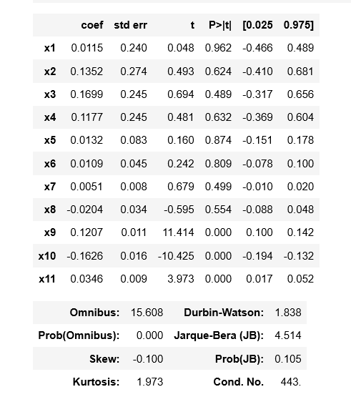
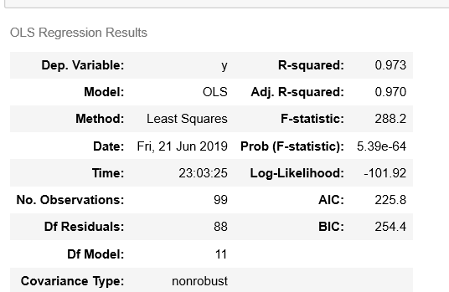
Important Code Snippets

Slide 8
contd...
R-squared - explain the amount of variance of the model. As for the good model it should be high, we got 0.973.
Adjusted Rsquare - Goodness of fit(). We got it as 0.970 which is almost high. Hence this is a good model.
p>[t] - Probability Test. Since it is < 5% Alpha (0.05) then REJECT Null Hypothesis. Since, there is a significant relation between the attributes.

Slide 9
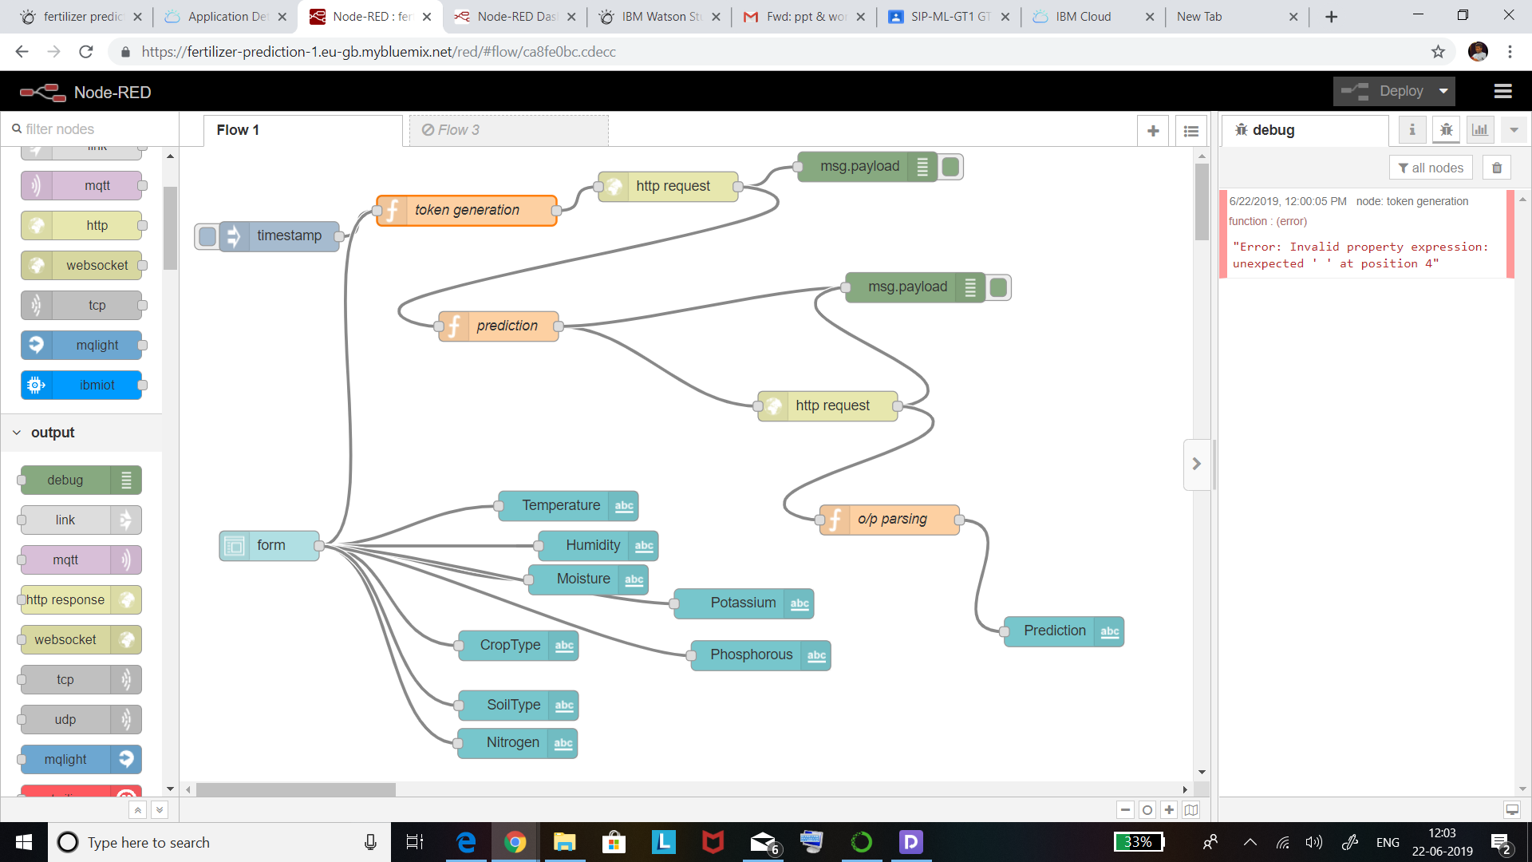
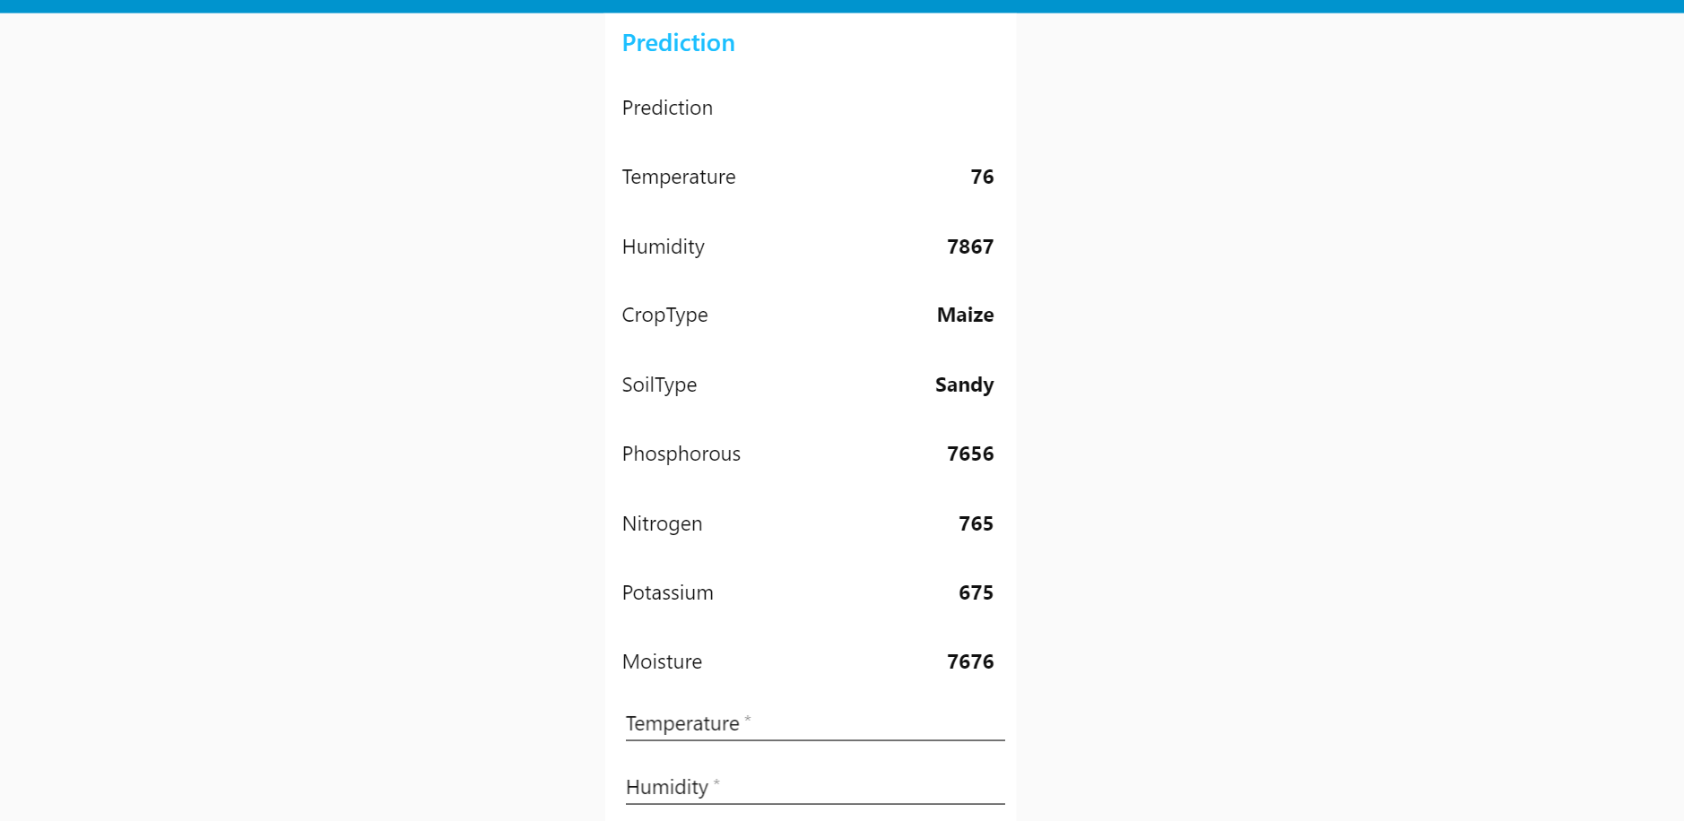
User Interface

Slide 10
Conclusion
Analyzing the large sets regularly results in returning the sustainable fertilizer to the framer. The best fertilizer based on yield rate are being researched that fits exactly for the problem.

